Slide 1
Name : Dr. Sanjib Pramanik
Name of the College : Durga College, Raipur (C.G.), India
Name of the Faculty : Arts
Designation : Assistant Professor, Department of Geography
Topic : STRUCTURE OF THE EARTH’S INTERIOR
Date : 27/02/2024

Slide 2
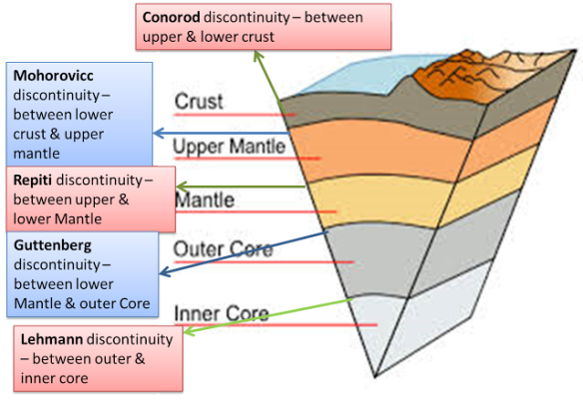
Structure of The Earth’s Interior
Dr. Sanjib Pramanik
Assistant Professor
Department of Geography
Durga College, Raipur

Slide 3
Introduction
It is not possible to know about the earth’s interior by direct observations because of the huge size and the changing nature of its interior composition.
It is an almost impossible distance for the humans to reach till the centre of the earth (The earth’s radius is 6,370 km).
Through mining and drilling operations we have been able to observe the earth’s interior directly only up to a depth of few kilometres.
The rapid increase in temperature below the earth’s surface is mainly responsible for setting a limit to direct observations inside the earth.
But still, through some direct and indirect sources, the scientists have a fair idea about how the earth’s interior look like.

Slide 4
Sources of Information About the Interior of the Earth
1. Direct Sources:
Rocks from mining area
Volcanic eruptions
2. Indirect Sources
By analyzing the rate of change of temperature and pressure from the surface towards the interior.
Meteors, as they belong to the same type of materials earth is made of. Gravitation, which is greater near poles and less at the equator.
Gravity anomaly, which is the change in gravity value according to the mass of material, gives us information about the materials in the earth’s interior.
Magnetic sources.
Seismic Waves: the shadow zones of body waves (Primary and secondary waves) give us information about the state of materials in the interior.

Slide 5
SEISMIC WAVES
P-Waves
S-Waves
Surface Waves

Slide 6
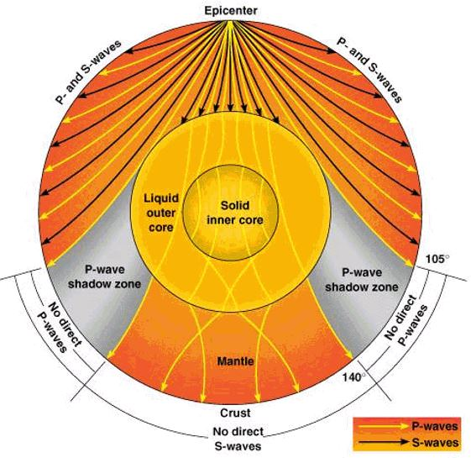
P-Waves
Primary (they arrive first), Pressure, or Push-Pull.
Material expands and contracts and particles move back and forth in the path of wave.
Sound waves that travel through solids, liquids or gasses.
S-Waves
Secondary (arrive later), Shear, or Side-to-side.
Material shears out of shape and snaps back.
Travels only through solids.

Slide 7
Contd...
Surface Waves
Travel along the earth’s surface.
The slowest waves but the ones that damage in large earthquakes.
Wave Shadow Zone
The seismic shadow zone is the rea of the Earth's surface where seismographs cannot detect an earthquake after the waves have passed through the earth.
P waves are refracted by the liquid outer core and are not detected between 104° and 140°.
S waves cannot pass through the liquid outer core and are not detected beyond 104°.
This information led scientists in the early 1900s to deduce a liquid outer core

Slide 8
Structure of Earth’s Interior is Fundamentally Divided into Three Layers
Crust
Mantle
Core

Slide 9
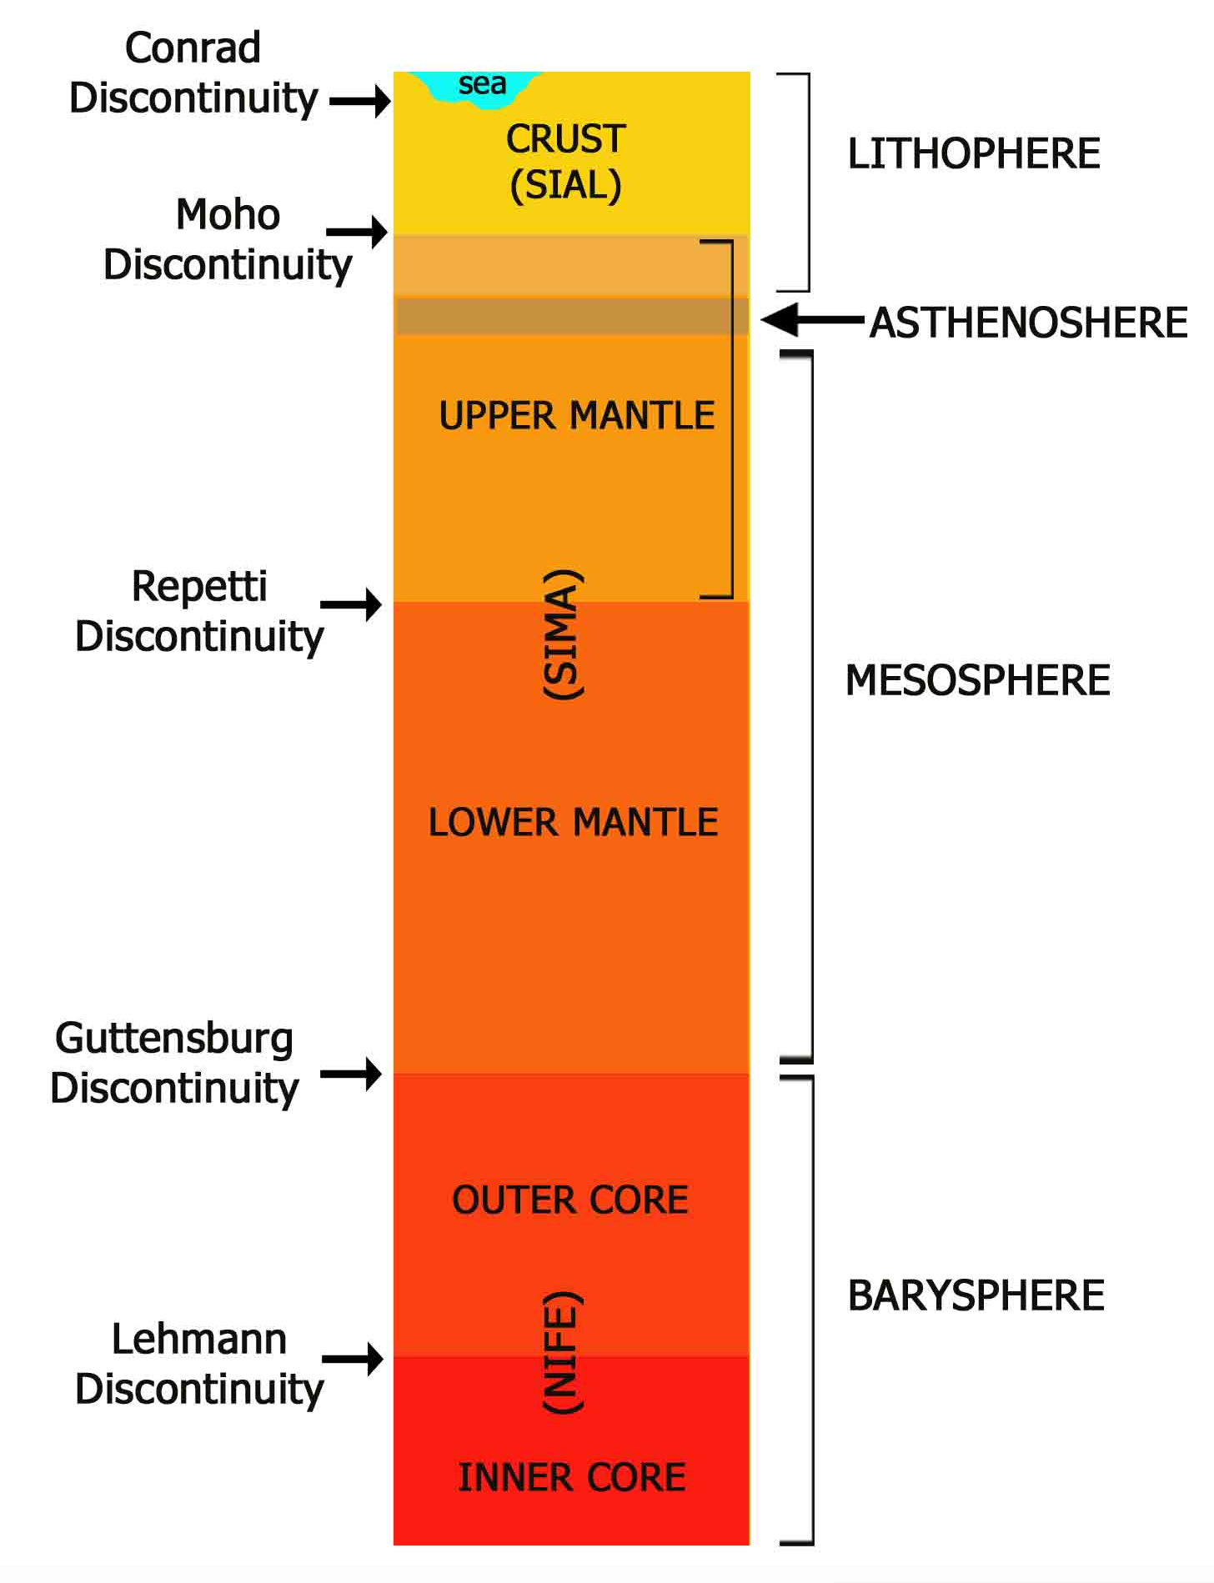
Discontinuities

Slide 10
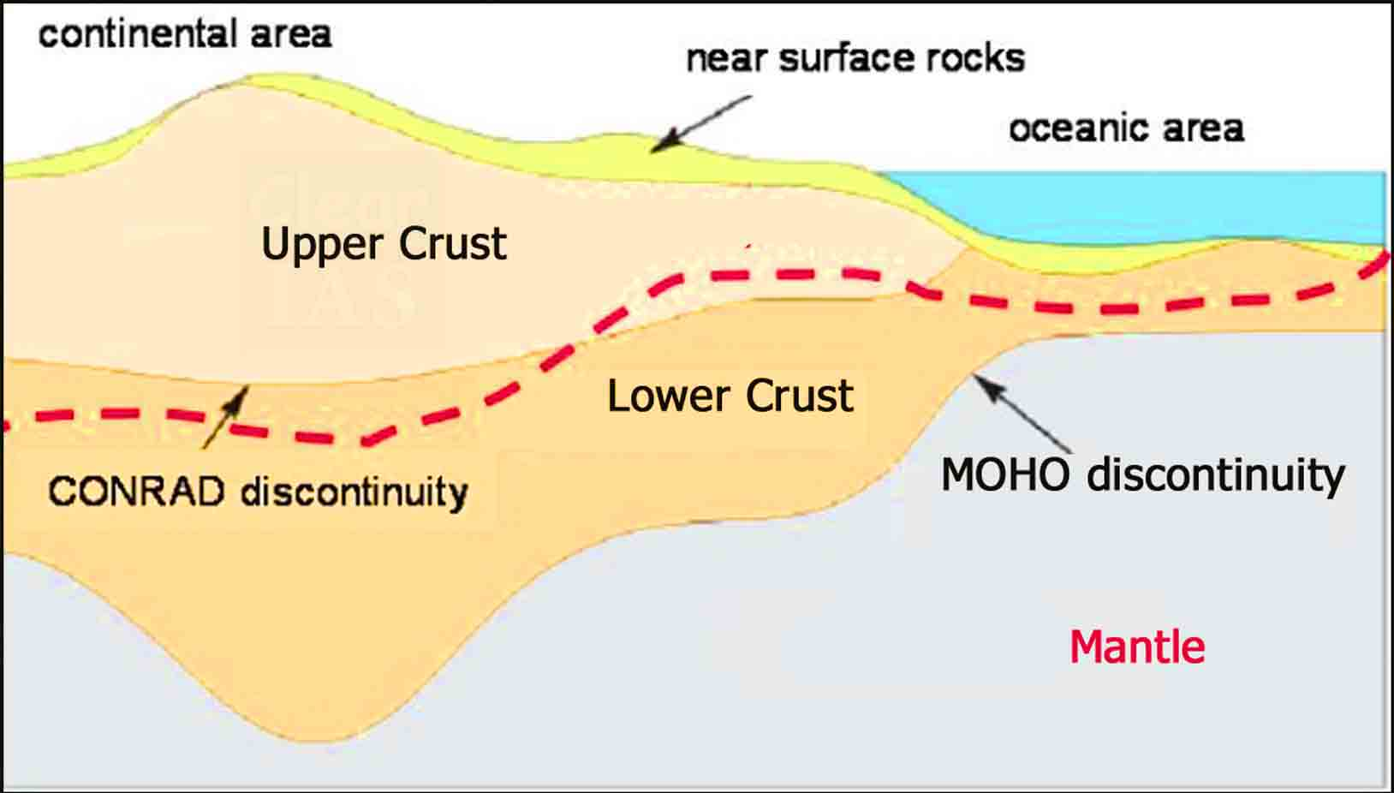
Crust
It is the outermost solid part of the earth, normally about 8-40 kms thick.
It is brittle in nature.
Nearly 1% of the earth’s volume and 0.5% of earth’s mass are made of the crust.
The thickness of the crust under the oceanic and continental areas are different. Oceanic crust is thinner (about 5kms) as compared to the continental crust (about 30kms).
Major constituent elements of crust are Silica (Si) and Aluminium (Al) and thus, it is often termed as SIAL (Sometimes SIAL is used to refer Lithosphere, which is the region comprising the crust and uppermost solid mantle, also).
The mean density of the materials in the crust is 3g/cm3.
The discontinuity between the hydrosphere and crust is termed as the Conrad Discontinuity.

Slide 11
Mantle
The portion of the interior beyond the crust is called as the mantle.
The discontinuity between the crust and mantle is called as the Mohorovich Discontinuity or Moho discontinuity.
The mantle is about 2900kms in thickness.
Nearly 84% of the earth’s volume and 67% of the earth’s mass is occupied by the mantle.
The major constituent elements of the mantle are Silicon and Magnesium and hence it is also termed as SIMA.
The density of the layer is higher than the crust and varies from 3.3 – 5.4g/cm3.
The uppermost solid part of the mantle and the entire crust constitute the Lithosphere.
The asthenosphere (in between 80-200km) is a highly viscous, mechanically weak and ductile, deforming region of the upper mantle which lies just below the lithosphere.
The asthenosphere is the main source of magma and it is the layer over which the lithospheric plates/ continental plates move (plate tectonics).
The discontinuity between the upper mantle and the lower mantle is known as Repetti Discontinuity.
The portion of the mantle which is just below the lithosphere and asthenosphere, but above the core is called as Mesosphere.

Slide 12
Core
It is the innermost layer surrounding the earth’s centre.
The core is separated from the mantle by Guttenberg’s Discontinuity.
It is composed mainly of iron (Fe) and nickel (Ni) and hence it is also called as NIFE.
The core constitutes nearly 15% of earth’s volume and 32.5% of earth’s mass.
The core is the densest layer of the earth with its density ranges between 9.5-14.5g/cm3.
The Core consists of two sub-layers: the inner core and the outer core.
The inner core is in solid state and the outer core is in the liquid state (or semi-liquid).
The discontinuity between the upper core and the lower core is called as Lehmann Discontinuity.
Barysphere is sometimes used to refer the core of the earth or sometimes the whole interior.

